Slide 1
The PULSE trial
Effect of next generation pulsatile mechanical circulatory support on
Effect of next generation pulsatile mechanical circulatory support on cardiac mechanics

Slide 2
Introduction - Context
Percutaneous Mechanical Circulatory Support (MCS) is gaining space among Interventional Cardiologists
Short-term MCS aims to improve clinical outcomes in Cardiogenic Shock and in high-risk PCI
MCS acts by reducing the myocardial oxygen demand while maintaining systemic and coronary perfusion
The BCIS-1 trial showed 12% less hemodynamic instability during elective high-risk PCI and reduced mortality in the long term
The Protect II trial: the largest randomized clinical trial comparing a trans-aortic device and IABP in high-risk PCI showed that the trans-aortic approach reduced MACCE at 90 days compared to IABP
Current indication for short term MCS (2021 Joint EAPCI/ACVC Expert Consensus):
HR-PCI: May be considered in highly selected patients in case of acceptable femoral access
AMI without CS: appears to be feasible as a preventive unloading strategy although that requires more evidence
CS: may be used as a short-term therapy where there is potential for reversibility / transplant / or patient is candidate to long-term MCS
Efficacy is measured by clinical endpoints and hemodynamics
Intra-cardiac Pressure-volume Loops are the preferred method for evaluation of cardiac mechanics for hemodynamic evaluation
No studies have previously assessed the hemodynamic changes produced by PulseCath iVAC 2L and data on other devices is very limited.
Protect II trial. (O’Neill et al, Circulation, 2012;126 (14):1717-27) Patients requiring hemodynamic support during non-emergent High-Risk PCI on unprotected LM/last patent conuit and LVEF <35% or 3 vessel disease and LVEF <30% (n=216). 1:1 IABP + PCI or IMPELLA 2.5 + PCI
Notes:
Today, percutaneous mechanical circulatory support is gaining space in cathlabs with increasing adoption by operators.
BCIS-1 trial: N=301 (151 IABP and 150 without IABP)
Long-Term Mortality Data From the Balloon Pump–Assisted Coronary Intervention Study (BCIS-1)
A Randomized, Controlled Trial of Elective Balloon Counterpulsation During High-Risk Percutaneous Coronary Intervention

Slide 3
Multiple MCS Technologies and Efffects
IABP is placed in the ascending aorta. It adds 0.5 L/min to the native output, which is regarded as insufficient.
Impella /Heartmate PhP / iVAC 2L are placed across the aortic valve with the tip inside the LV (trans-aortic placement). They provide an additional output between 1.0 and 5.0 L/min.
Impella and PHP are micro-axial flow devices, system that has been related to increased hemolysis.
TandemHeart and V-A ECMO are also related to increased hemolysis. They provide higher flow rates but eject blood against the heart and overload it. They are also trickier to implant and cause more vascular complications. Vascular complications reportedly result in worse clinical outcomes.
iVAC 2L works trans-aortically but is pneumatically driven – and that reduces the risk of hemolysis.

Slide 4
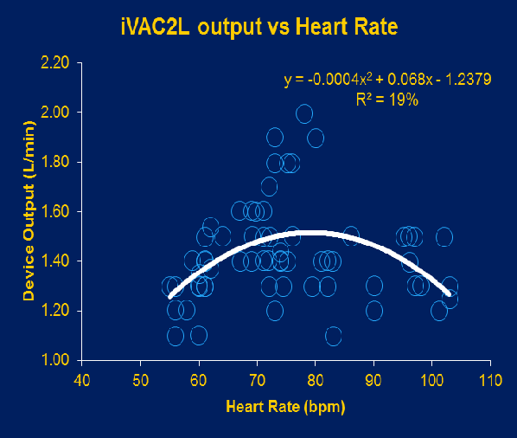
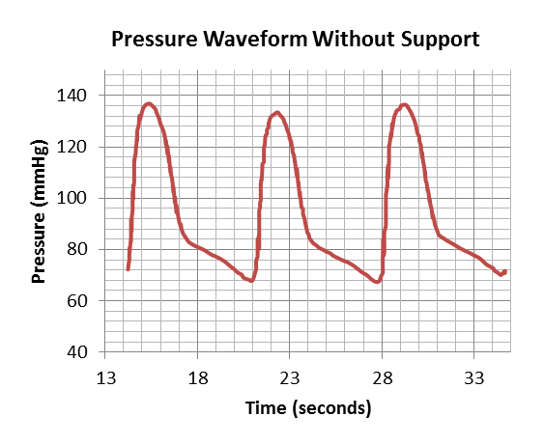
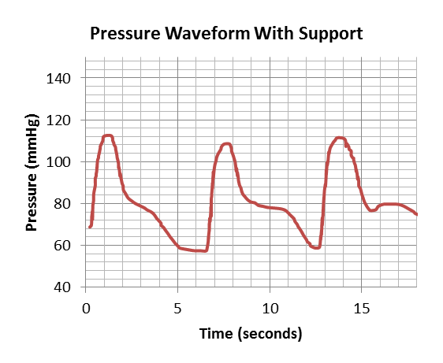
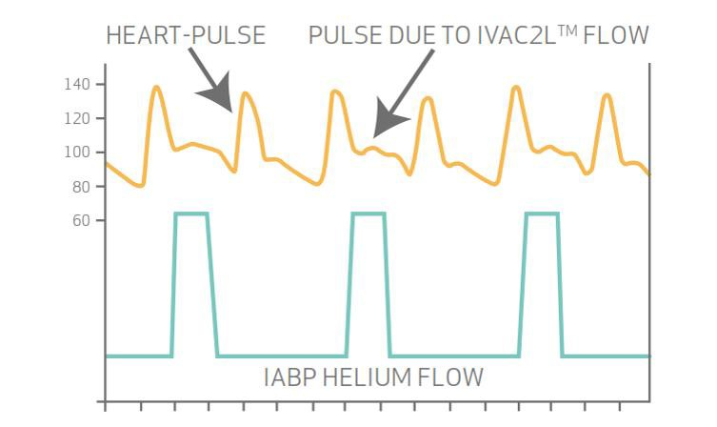
PulseCath iVAC 2L – Device Characteristics
Bi-directional flow
Entirely percutaneous
LV-to-aorta support
21mL added to the innate SV
Counterpulsation
Driven by an IABP console
Van Mieghem et al. EuroIntervention 2015;11:835-9 Den Uil et al. EuroIntervention 2017;12:1689-96 Bastos MB et al. EuroIntervention 2018 Feb 13

Slide 5
Summary Clinical Data on PulseCath iVAC 2L
PUB. YEAR | NUMBER OF INDIVIDUALS | AUTHOR | JOURNAL | RESULTS | TITLE
2015 | 01 | Van Mieghem | Eurointervention | Technical Report describing the implantation technique for iVAC 2L. | The PulseCath iVAC 2L left ventricular assist device: conversion to a percutaneous transfemoral approach
2017 | 14 | Den Uil | Eurointervention | Pivotal study of 14 patients using iVAC2L during High-risk PCI. Results indicate hemodynamic improvements, with no hemolysis. | Pulsatile iVAC 2L circulatory support in high-risk percutaneous coronary intervention
2017 | 01 | Samol | Future Cardiology | Documentation of the first case of iVAC2L to be treated in Germany, where the device has led to an uneventful procedure | First high-risk percutaneous coronary intervention under use of the iVAC2L system in Germany
2018 | 01 | Samol | Future Cardiology | Case report documenting 10mmHg increase in MAP and good stability in a case of high-risk PCI that complicated in the Cathlab. | First successful prevention of cardiopulmonary resuscitation during high-risk percutaneous coronary intervention by use of a pulsatile left ventricular assist device: baptism of fire of the iVAC2L device: a case report
2018 | 01 | Bastos | Eurointervention | Case report (Patient #1 of the PULSE trial) that shows Pressure-volume changes following activation of iVAC 2L. | Haemodynamic impact of a new pulsatile mechanical circulatory support in high-risk coronary stenting
2019 | 20 | Samol | International Journal of Cardiology | Prospective study evaluating clinical and hemodynamical efficacy of iVAC 2L in elective High-risk PCI. | High-risk PCI under support of a pulsatile left ventricular assist device – First German experience with the iVAC2L system. International Journal of Cardiology
2020 | Clinical review | Bastos | Future Cardiology | Description of iVAC 2L design, mechanisms, hemodynamic effects and clinical applications | PulseCath iVAC2L: next-generation pulsatile mechanical circulatory support
2020 | 01 | Tzikas | Hellenic Journal of Cardiology | Case report on the use of iVAC 2L in cardiogenic shock with effective support for > 48h | First implantation of the pulsatile left ventricular assist device iVAC2L in a heart failure patient infected with influenza type A
2020 | 01 | Alekyan | Complex Issues of Cardiovascular Disease | Report of the use of iVAC 2L in high-risk PCI, mentioning hemodynamic stability during the entire procedure and no adverse events. | The Clinical Case of the First High Risk Percutaneus Coronary Intervention Under Use of the PulseCath iVAC 2L Left Ventricular Assist Device in Russia
2020 | 01 | Dedic | JACC case reports | First description of the use of MCS (including iVAC 2L) in cardiac arrest using Pressure-Volume Loops. | Pressure-Volume Loop Analysis in Percutaneous Coronary Intervention-Induced Shock - ScienceDirect
2022 | 29 | Bastos MB | Cardiovascular Revascularization Medicine | Evaluation of Hemodynamic Efficacy using Intracardiac Pressure-Volume Loops. Shows cardiac unloading and elevations in MAP after iVAC 2L is activated. | Effect of next generation pulsatile mechanical circulatory support on cardiac mechanics - The PULSE trial
2022 | 174 | PulseCath | ---- | Post-market Surveillance Registry of clinical and hemodynamic endpoints in patients receiving iVAC 2L. | Data not published.
TD A2 2.3 Summary of Safety and Clinical Performance iVAC 2L

Slide 6
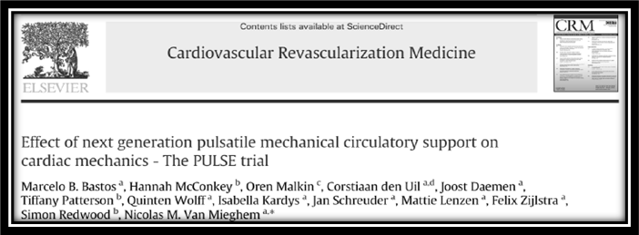
PULSE Trial
Objective: To describe the cardiovascular changes induced by iVAC 2L and the resulting clinical endpoints.
Design: prospective single-arm two center study with patients undergoing high-risk PCI under mechanical circulatory support and monitored using intra-cardiac Pressure-volume Loops.
Primary endpoint: demonstration of LV unloading after activation of the device.
Secondary endpoint: Safety parameters (in-hospital and 30-days).
Principal Investigators:
MB. Bastos (Research Fellow at the ThoraxCentrum)
Prof. N.M. van Mieghem Erasmus University Medical Center, Rotterdam, The Netherlands

Slide 7
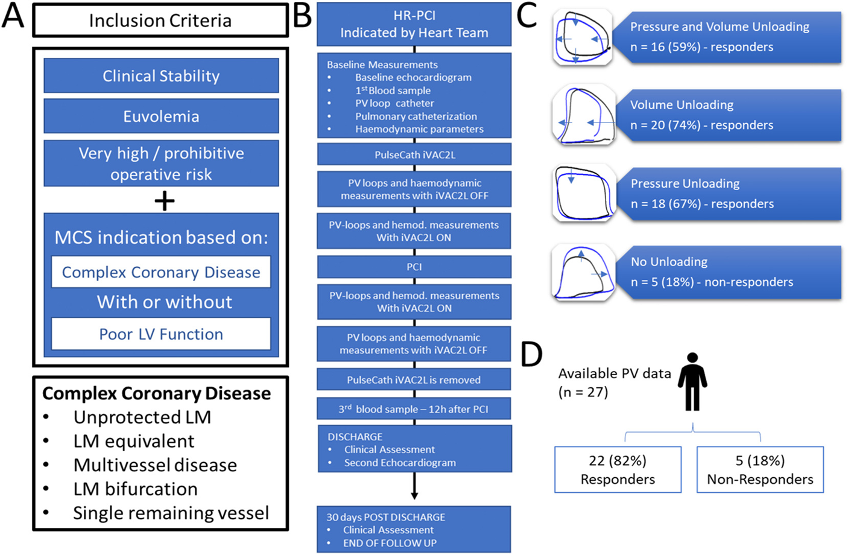
Notes:
Inclusion criteria: patients had to be clinically stable, without evidence of fluid depletion or overload, should have a very high operative risk in addition to poor LV function or very complex coronary disease that could lead to significant instability during coronary manipulation. On the bottom, the elements required to define a case as for high-risk PCI. Please note that absence of low ejection fraction was not an exclusion criteria – the study was more focuse on the risk of crashing intraprocedurally due to multiple factors.
Study flowchart
Pressure-volume changes after activation. In 59% of all cases the PV loop shifted completely to the left and downward (what is the ideal response. 74% of the study population showed left shift with or without downward shift indicating volume unloading and 67% showed downward shift with or without left shift, denoting pressure unloading. Only 5 individuals had no evidence of unloading and were qualified as non-responders. Therefore, the study shows that iVAC2L was effective in 82% of the cases.

Slide 8
PV loops from responders show left and downward shift with iVAC 2L ON (blue) relative to OFF (black).
PV loops from non-responders show no clear shift.
Classifying patients according to the presence of mitral regurgitation or recent admission due to an acute coronary syndrome results in a similar pattern observed in responders x non-responders. Patients with MR and/or ACS had on average more intense unloading response than others. This suggests could be potential predictors of unloading response to iVAC 2L and possibly to other trans-aortic devices.

Slide 9
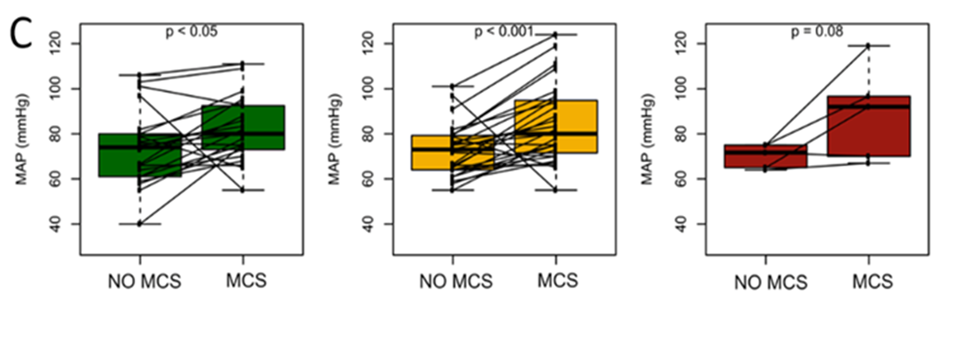
Outside of the heart, in the aorta and the arterial system as a whole, iVAC 2L resulted in a clear increment on the Mean Arterial Pressure (MAP).
Green: Changes in MAP in Responders
Yellow: Changes in MAP in the whole study population.
Red: Changes in MAP among non-responders.
The data shows that with very few exceptions, the increase in MAP was observed in all patients in the study and that was not affected by the absence of LV unloading among non-responders.

Slide 10
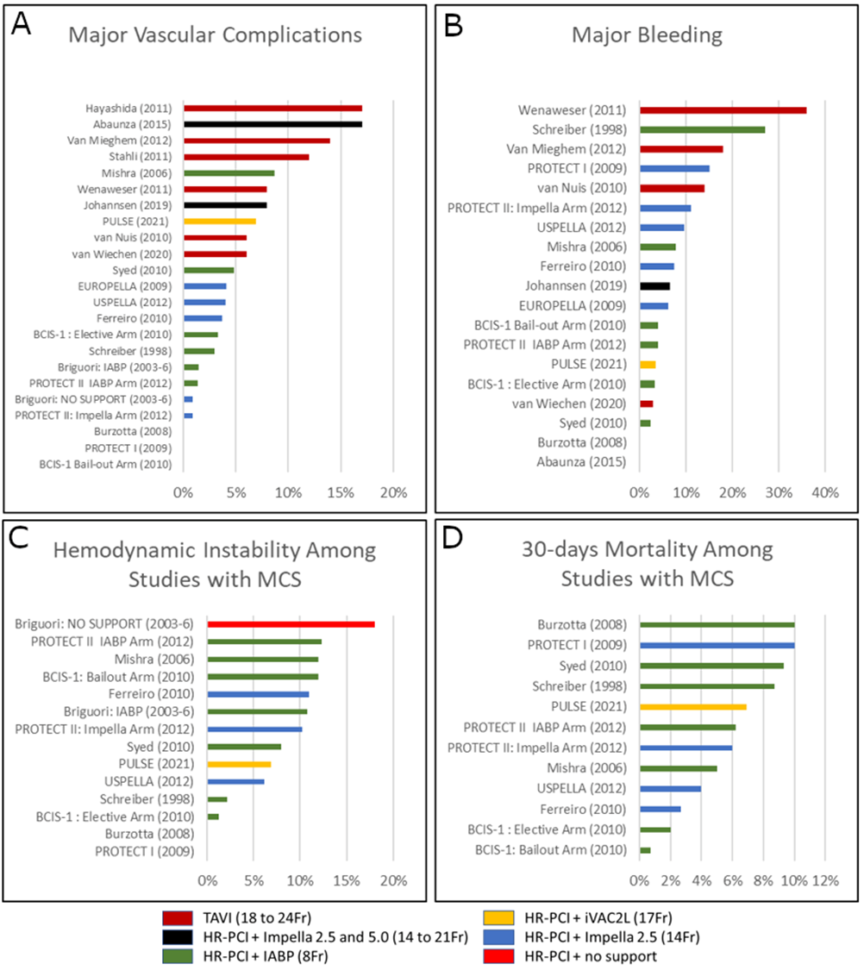
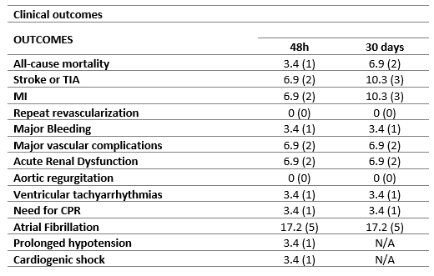
Clinical Outcomes in the PULSE trial
Important: the PULSE trial is not powered to allow for definitive conclusions on clinical endpoints.
Notes:
The graphics on the right put the rates obtained in the PULSE trial into context. Compared to other studies using large-bore catheters, panels (A) and (B) show that the rates of Major Vascular Complications and Major Bleeding after 30 days are among the lowest, with several studies reporting higher rates. Overall, rates are in line with the literature on large-bore catheters. Large bore catheter is defined as any catheter measuring more than 7Fr in diameter.
In Panel C, the rate of hemodynamical instability is compared with other studies applying short-term MCS (only MCS – no TAVI or other large bore interventions). Most studies reported higher rates of hemodynamical instability during support, some of them using the Impella system. It is noteworthy to mention that rate of hemodynamical instability reported in two studies released by Briguori et al ( which are among the earliest reports on HR-PCI using MCS)
In Panel D, 30-days mortality data shows similar rates between the PULSE trial and other studies such as the PROTECT II. It is possible that the small sample size has somewhat inflated the mortality rate.

Slide 11
Conclusion
The trial demonstrates:
iVAC 2L MCS provides demonstrable LV unloading and reduction in myocardial oxygen consumption in most patients
Cardiac mechanics improved particularly in patients with acute coronary syndrome (ACS) or significant mitral regurgitation (MR)
High risk PCI with iVAC 2L MCS was feasible in patients with advanced coronary artery disease (CAD) at very high to prohibitive operative risk
iVAC 2L unloaded the LV and increased its efficiency High-risk PCI. Larger studies are required to confirm these findings.

Slide 12
Overall Conclusion Summary Clinical Data on PulseCath iVAC 2L
In conclusion, the clinical data provides evidence for the iVAC 2L’s proposed indications, and the probable benefit-risk relation is favorable. Current experience with PulseCath iVAC 2L indicates that the device is safe and effective, being suitable for the intended purposes with lower-than-expected rates of residual risks, when applied by qualified hands.

Slide 13
THANK YOU

