Slide 1
iVAC 2L Product Presentation
V112022_001

Slide 2
PulseCath
A Netherlands based medical device company that develops, manufactures and markets mechanical circulatory support (MCS) system.
Our Mission
To provide effective circulatory support systems to the cardiologist and the cardiac surgeon that address a wide range of patients through novel solutions that reduce healthcare costs and improve patient outcomes.

Slide 3
PulseCath Milestones

Slide 4
Background to Short Term Mechanical Circulatory Devices
Intra-aortic balloon pumps (IABP)
non-IABP percutaneous mechanical circulatory assist devices
extracorporeal membrane oxygenator pumps (ECMO)
Non percutaneous centrifugal pumps, which are used for cardiopulmonary bypass
Short-term mechanical circulatory assist devices are designed to provide hemodynamic support for a wide range of clinical conditions
prophylactic insertion for high-risk invasive coronary artery procedures to the management of cardiogenic shock
acute decompensated heart failure
or cardiopulmonary arrest
These devices provides circulatory support by performing work for a failing left or right ventricle or both
There has been a significant increase in the use of short-term percutaneous ventricular assist devices (pVADs) as acute circulatory support in cardiogenic shock and to provide hemodynamic support during interventional procedures, including high-risk PCI
There are four major categories of circulatory assist devices:

Slide 5
iVAC 2L
iVAC 2L is a short term Pulsatile Mechanical Circulatory Support System in the form of a pVAD (Percutaneous Ventricular Assist Device) that effectively generates blood flow of up to 1.5 liters per minute
Its application as hemodynamical backup may also result in more extensive treatment of the coronary lesions and improved long-term clinical outcomes and improve myocardial perfusion and optimize the cardiac workload, thus reducing the likelihood of peri- and post-procedural adverse events
It works by actively unloading the left ventricle to provide critical hemodynamic support for patients being treated for acute myocardial infarction and cardiogenic shock

Slide 6
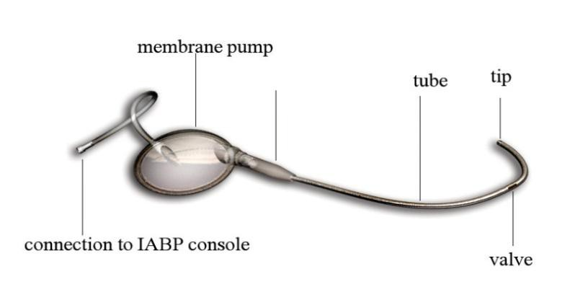
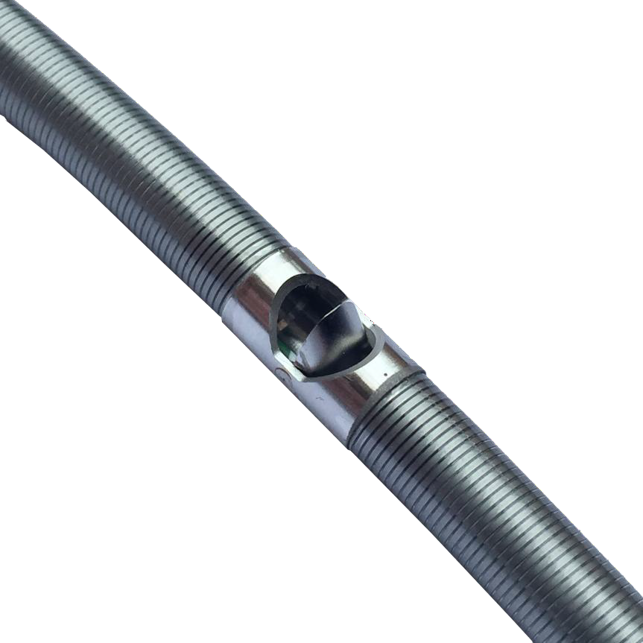
What does it consist of?
17Fr flexible thin-walled catheter
Bi-directional valve
Single port 40cc membrane pump
Delivered via 18Fr braided, hydrophilic delivery sheath
Run by an IABP console
Bastos, Marcelo B et al. “PulseCath iVAC2L: next-generation pulsatile mechanical circulatory support.” Future cardiology vol. 16,2 (2020): 103-112.

Slide 7
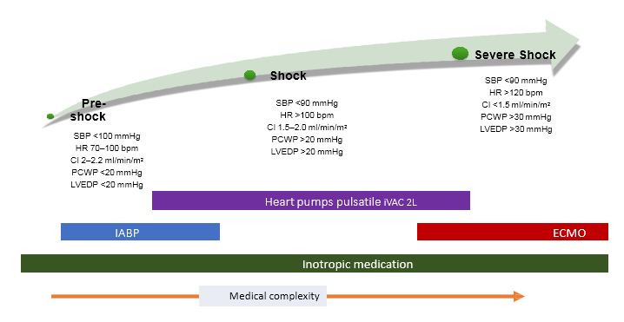
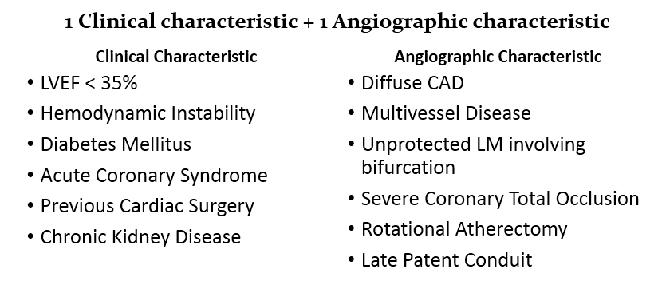
Where can it be used?
Indications
Protected high-risk PCI*
Cardiogenic shock - In patients where IABP isn’t enough and ECMO is too severe
*
Contra indications include*: Femoral artery diameter <6mm, Severe Aortic stenosis, Thrombus in LV, Presence of a mechanical aortic valve
*please check the PulseCath iVAC 2L Instructions for Use for other contra indications
Arri, Satpal S et al. “Myocardial revascularisation in high-risk subjects.” Heart (British Cardiac Society) vol. 104,2 (2018): 166-179.
Bastos, Marcelo B et al. “PulseCath iVAC2L: next-generation pulsatile mechanical circulatory support.” Future cardiology vol. 16,2 (2020): 103-112.
J Am Coll Cardiol. 2015 May 19;65(19):e7-e26

Slide 8
Percutaneous Coronary Intervention
Percutaneous coronary intervention (PCI) is a non-surgical procedure used to treat narrowing of the coronary arteries of the heart found in coronary artery disease
Indications for PCI include the following: Acute ST-elevation myocardial infarction (STEMI) Non–ST-elevation acute coronary syndrome (NSTE-ACS) Unstable angina
More than 600 000 (PCIs) are performed in the United States each year, accounting for over $12 billion in healthcare spending.
The number of PCI centers has grown 21.2% over the last 8 years
39% of all hospitals having interventional cardiology capabilities
Theodore Bass, MD, from University of Florida College of Medicine
Appropriateness of Percutaneous Coronary Intervention
Paul S. Chan

Slide 9
Types of PCI and what constitutes high-risk PCI?
Balloon angioplasty
Laser angioplasty
Rotational atherectomy
Angioplasty with a stent
MCS-supported PCI
*Arri, Satpal S et al. “Myocardial revascularisation in high-risk subjects.” Heart (British Cardiac Society) vol. 104,2 (2018): 166-179.

Slide 10
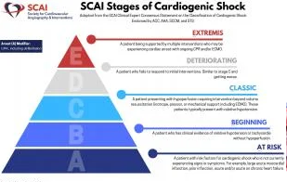
Cardiogenic Shock
Cardiogenic shock remains a challenging condition with mortality rates of approx 50%
Cardiogenic shock is essentially circulatory failure, as a consequence of left, right or biventricular dysfunction
The heart in unable to sufficiently pump enough blood to meet needs of the body
Heart problems that cause cardiogenic shock include:
Unstable angina
Heart attack/myocardial infarction
Certain abnormal heart rhythms
Heart failure
Heart defects
Challenges in the conduct of randomised controlled trials in cardiogenic shock complicating acute myocardial infarction
Anne Freund

Slide 11
Cardiogenic Shock
Cardiogenic shock is not only decreases cardiac contractile function, but is responsible for multiorgan dysfunction syndrome involving the entire circulatory system
Cardiogenic shock is managed by early diagnosis and directed therapy to optimize oxygen delivery and tissue perfusion
The field of temporary mechanical circulatory support to manage patients with cardiogenic shock has advanced in the last decade
Early intervention with adequate selection of the most appropriate mechanical circulatory support device may improve outcomes

Slide 12
iVAC 2L: Features – Benefits - Advantages
FEATURES
Transfemoral pVAD system
BENEFITS
Ease of use, short learning curve
ADVANTAGES
Swift percutaneous approach, also in emergency situations
Sheath or sheathless insertion approach
17Fr single lumen, bi-directional flow catheter providing pulsatile support
ECG or AP triggered counter pulsation
Driven and compatible with standard IABP consoles
Reduced strain on heart muscle
Improvement in hemodynamic parameters that effect the organs
Unloading of the LV reducing afterload aortic pressure
Improves cardiac output
Cost effective
Reduce ventricular volume and pressure
Non-significant hemolysis, fHb<10 mmol/L
Standard transfemoral, percutaneous approach that follows routine procedure
Improves coronary artery and end-organ perfusion

Slide 13
How does it work?
The iVAC 2L is activated by standard IABP console that is triggered by ECG /AP
The helium from IABP console is “pushing and pulling” the iVAC 2L membrane pump synchronized with heart beats
During systole, blood enters the catheter through its tip located at the left ventricular and is aspirated into the membrane pump
The membrane pump pushes the blood back in the catheter, the valve at the side hole opens, and ejects the blood out sideways to aorta during diastole

Slide 14
View on X-ray
iVAC 2L in position on X-ray
iVAC 2L in action as seen on Fluoroscopy

Slide 15
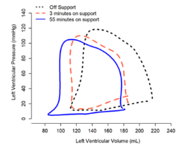
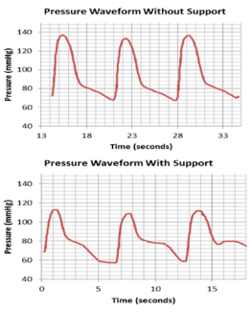
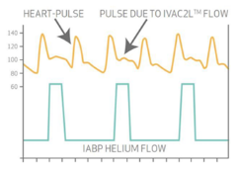
Impact of iVAC 2L as seen on PV Loop and Waveform
A significant shift to the left and south is observed on use of iVAC 2L
iVAC 2L increases pressure diastolic providing additional diastolic flow without taking over LV ejection fraction volume
Bastos, Marcelo B et al. “PulseCath iVAC2L: next-generation pulsatile mechanical circulatory support.” Future cardiology vol. 16,2 (2020): 103-112.

Slide 16
iVAC 2L Mechanical Unloading
Impact of iVAC 2L in heart failure patients
Improvement in heart work efficacy
Improvement in systematic hemodynamics
LV volumes and pressure show significant increase
The Arterial Elastance (Ea), reflecting the forces opposing blood ejection by the LV, is reduced significantly and consistently after activation of iVAC 2L
Total systemic resistance is significantly reduced after iVAC 2L activation as the blood reaches the peripheral circulation more easily
The global cycle efficiency is significantly improved
Bastos, Marcelo B et al. “PulseCath iVAC2L: next-generation pulsatile mechanical circulatory support.” Future cardiology vol. 16,2 (2020): 103-112.

Slide 17
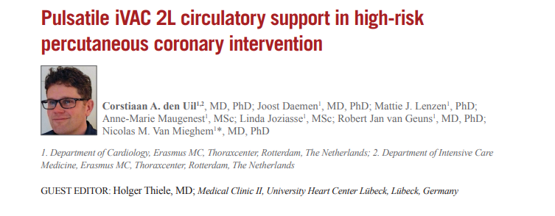
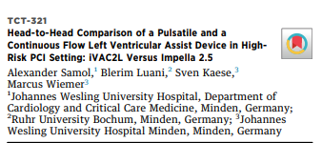
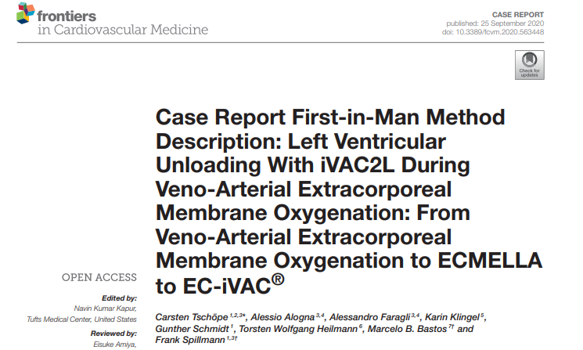
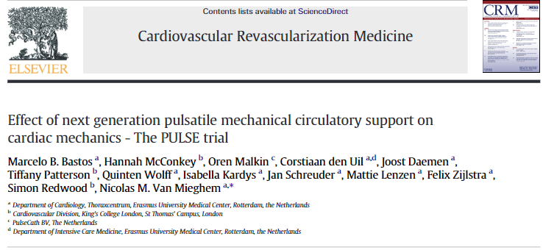
Clinical Studies
Over 30 articles and trials published
15 since 2017
PULSE Trial* most recently published in the CRM
*Effect of next generation pulsatile mechanical circulatory support on cardiac mechanics - The PULSE trial. Cardiovascular Revascularization Medicine, March 2022
Marcelo B. Bastos , Hannah McConkey, Oren Malkin, Corstiaan den Uil, Joost Daemen, Tiffany Patterson, Quinten Wolff, Isabella Kardys, Jan Schreuder, Mattie Lenzen, Felix Zijlstra, Simon Redwood, Nicolas M. Van Mieghem

Slide 18
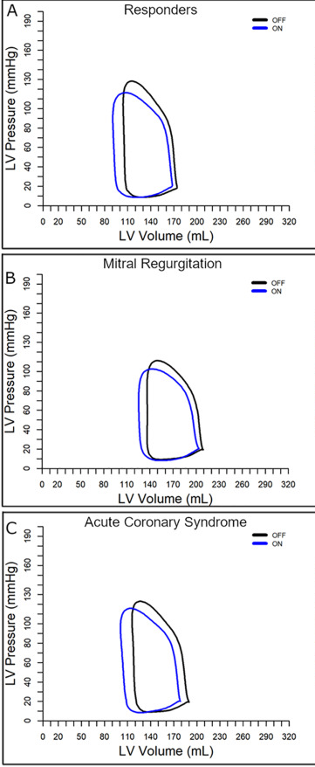
Effect of next generation pulsatile mechanical circulatory support on cardiac mechanics – The PULSE trial
Mechanical circulatory support with PulseCath iVAC 2L in high-risk percutaneous coronary interventions offers LV unloading and reduces myocardial oxygen consumption particularly in patients with acute coronary syndrome or concomitant mitral regurgitation
The mean age was 74 (IQR: 70–81) years and the mean SYNTAX score was 31 ± 8.3
Left ventricular unloading with iVAC 2L MCS was demonstrated in 82% of patients with complete PV studies
90% of Patients with moderate or severe mitral regurgitation or presenting with acute coronary syndrome (ACS) were most responsive to iVAC 2L unloading
In 81% of patients significant reductions in afterload (Ea: −19%) with increases in stroke volume (+11%) and cardiac output (+11%)

Slide 19
Clinical outcome PULSE trial
PCI was feasible with iVAC 2L MCS in patients with advanced coronary artery disease and very high to prohibitive operative risks
Procedural success in 91% of cases
Reduction in Syntax score from 37±19 to 4.0 (IQR: 0 to 15.12)
30-day mortality 6.9%; comparable to PROTECT II outcomes: IABP 6.2% and Impella 6.9%
PULSE patients were at higher risk than in PROTECT II study yet procedures were more extensive and support times were shorter

Slide 20
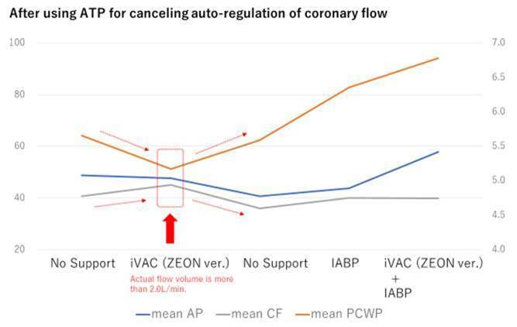
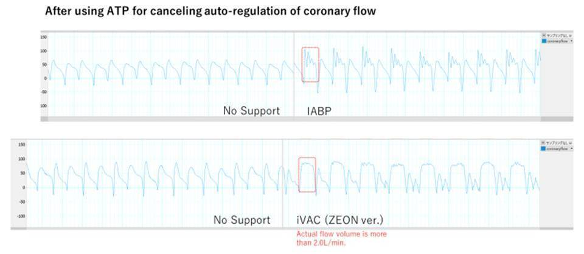
September 2021 Tokyo University – Dr. Saku
Comparison coronary flow iVAC 2L vs IABP
Total 2L 16 Vol >2L/m (Zeon IABP Console)
iVAC 2L increased coronary flow with reducing Pressure of left ventricular
iVAC 2L decrease PCWP (Pulmonary capillary wedge pressure)
iVAC 2L Waveform of coronary flow is different from its of IABP

Slide 21
Registry PMS - 174 patients – 24 Countries - 67 centers April 2022
Mean age was 69±11 years. (SYNTAX 37)
Patients tended to have multivessel disease and low ejection fraction (EF< 35%).
The median support time (IQR) of 71 (51-114) minutes.
An average flow of 1.5±0.2L/min.
Significant LM obstruction and three-vessel disease were present in 59% and 54% respectively.
Intraprocedural complications that resulted in the removal of the device in only two cases (1.1%).
Repeat Revascularization 0% Vs 3.2% Impella and 6.2% IABP*.
Major Bleeding 3%. Vs 5.1% Impella and 3.3% IABP*.
Hemodynamic Instability 7.7% Vs 10.2% Impella and 12.3% IABP*
MACCE** 30 Days – 12.1% Vs 14% Impella and 20% IABP*
Hemolysis (Clinical relevant) 0% Vs 11.8% Impella and 0% IABP*
Acute Kidney Injury – 6.1% Vs 13% Impella and 4.2% IABP*
*Comparison to Protect II and IMP-IT studies
** MACCE: composite endpoint of death, myocardial infarction, stroke and repeat revascularization after 30 days. TIA: Transient Ischemic Attack. AMI
R1058-1_PMS Registry Report iVAC 2L_2022-06-29

Slide 22
iVAC 2L vs Impella 2.5
40 patients iVAC 2L vs Impella 2.5 during protected high-risk PCI(LVEF 33%)
PCI Success in 98% of cases
Both devices led to a significant increase in aortic pressure
Both devices ensured stable hemodynamic conditions for performing successful high-risk PCI
Complication rates by use of both devices seem acceptable
Signs of potential hemolysis were only present under Impella 2.5
High-risk PCI’s under mechanical circulatory support by the pulsatile iVAC 2L or the continuous flow Impella 2.5 device are feasible and safe
Alexander Samol, Marcus Wiemer, Sven Kaese. Comparison of a pulsatile and a continuous flow left ventricular assist device in high-risk PCI. International Journal of Cardiology May 2022

Slide 23
Why use a Short Term Mechanical Circulatory Device during high-risk PCI?
Can be used to unload LV in combination with VA ECMO
Reduced complications during and post PCI
Maintains hemodynamic stability during complex PCI procedures
Provide hemodynamic stability during high risk VT ablation
Performing high-risk PCI’s normally create heart deuteration during blocking LM coronary with balloon In many cases this can force to stop procedure in order to let myocardial to recover In order to get to maximum outcome from one procedure the iVAC 2L can prevent patient collapsing and give the “safety net” needed to continue for next steps Not using safety net pump during these cases force you to perform the procedure in high speed only by senior and well experienced doctors
* Ameloot K, B Bastos M, Daemen J, Schreuder J, Boersma E, Zijlstra F, Van Mieghem NM.Top of Form New Generation mechanical circulatory support during high-risk PCI: a cross sectional analysis. EuroIntervention 2019.

Slide 24
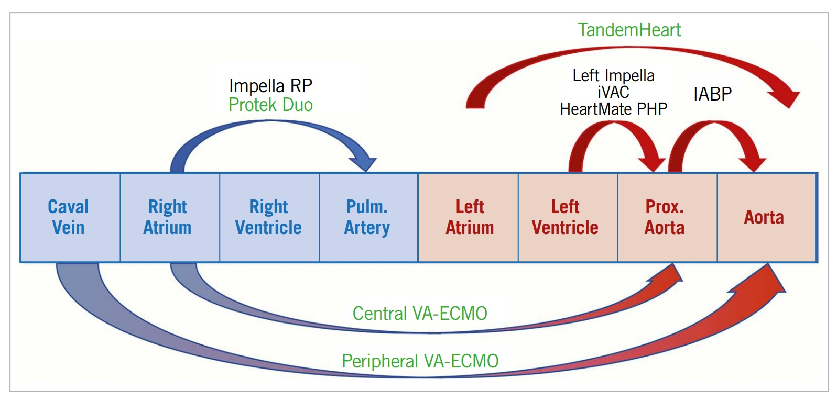
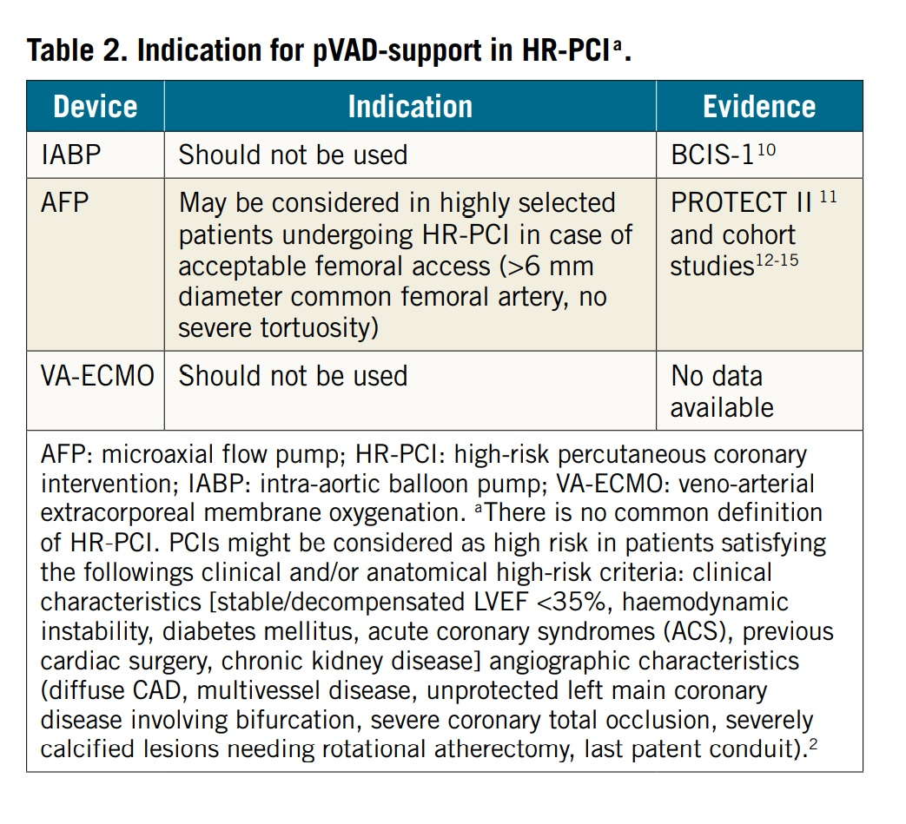
Guidelines Europe
IABP is not recommended for use in high-risk PCI procedures
European Guide lines recommendation (July 2021)
Joint EAPCI/ACVC expert consensus document on percutaneous ventricular assist devices. Eurointervention. 10.4244/EIJY21M05_01
European CE Mark since 2015 No. 144876 – Valid till April 2024
* Joint EAPCI/ACVC expert consensus document on percutaneous ventricular assist devices. European Heart Journal: Acute Cardiovascular Care (2021) 10, 570–583 doi:10.1093/ehjacc/zuab015

Slide 25
In conclusion
“ In a consecutive real-world cohort of high-risk PCI patients, protection with new-generation MCS resulted in better procedural outcomes despite worse EF and more complex coronary artery disease at baseline”
Ameloot K, B Bastos M, Daemen J, Schreuder J, Boersma E, Zijlstra F, Van Mieghem NM.Top of Form New Generation mechanical
circulatory support during high-risk PCI: a cross sectional analysis. EuroIntervention 2019.

Slide 26
The effect of pulsatile support over continuous flow?
BOTH PROVIDE SIMILAR SUPPORT TO A FAILING HEART
Pulsatile systems work with the heart, giving output from the device and also the natural cardiac output therefore giving increased flow
Continuous flow replaces the output of the ventricle
Stroke volume of heart
+
stroke volume of device
≈
pumping greater volume of blood through the body
Bastos, Marcelo B et al. “PulseCath iVAC2L: next-generation pulsatile mechanical circulatory support.” Future cardiology vol. 16,2 (2020): 103-112.

Slide 27
What are the risks of hemolysis using iVAC 2L?
Every pump creates some level of blood destruction
iVAC 2L almost does not damage the RBCs due to low negative pressure during suction and smooth membrane pump that keep smooth circle blood flow
Level of FHb is significantly lower than the Impella pump <10mg/DL in comparison to 50-100mg/DL in continuance flow pumps

Slide 28
Concerns about 18Fr sheath and limb ischemia…
Patient selection is key to success, similar to TAVI femoral Artery size need to be >5.7mm
Occluding lower extremities during PCI and then taking out the device, up to 3-4H have no significant effect on lower limb - never had a complication with this
In case using the device for more than 4H it is recommended to assess the lower limb Oxygen level with SPO2, if levels are low then it is recommended to perform bypass as per ECMO
There is always a possibility of a sheathless approach. This involves a small cutdown and using a purse-string surgical technique to close after the procedure. In this option, the size is dramatically smaller (comparable with that of a 15Fr sheath)

Slide 29
Wound closure and IABP console compatibility
How do I close the big wound?
You may use the same technique as with a TAVI procedure.
Double Proglide / Prostar closer device or the new Manta can be also used
What console shall I use with iVAC 2L ?
The iVAC 2L can be driven by any IABP drive (Arrow or Maquet) the setting is similar to IABP settings so not a huge learning process

Slide 30
Comparison of iVAC 2L to Impella CP
Different functions – Pulsatile support Vs Continuous flow
iVAC 2L although a smaller pump generates equivalent results to Impella CP
Works with the heart
No significant hemolysis in comparison to Impella CP
Easy to operate and time efficient
Cost effective
Clinical Effect | IVAC 2L | Impella CP
Cardiac output and systematic pressure changes* | LV volumes and pressures showed a significant increase. | LV volumes and pressures showed a significant increase.
The Effective Arterial Elastance (Ea)* | Decrease | Increase
Total Systemic Resistance* | Decrease | Increase
Global Cycle Efficiency* | Increase | No change
Aortic Afterload* | Decrease | Increase
PV Loop Changes* | Shifting to left and down | Shifting to right and Up
Hemolysis (fHb)* | <10 mg/dL | >50 mg/dL
Principle of action | Pulsatile | Continuance flow
Indications
 | High risk PCI, Unloading LV during ECMO (CS), High risk Ablation and Mapping | High risk PCI, Unloading LV during ECMO (CS)
Use and complications
Bleeding complications* | Very low | High
Procedure steps | Easy and intuitive | Complicated and involve high skill user
Learning time | Short | long
Learning new procedure and console | Not needed | needed
Economics
Cost (Europe) | ++ | ++++
Console | Standard IAB console | Dedicated Impella console
Based on clinical studies and publications
Alexander Samol, Marcus Wiemer, Sven Kaese. Comparison of a pulsatile and a continuous flow left ventricular assist device in high-risk PCI. International Journal of Cardiology May 2022
Bastos, Marcelo B et al. “PulseCath iVAC2L: next-generation pulsatile mechanical circulatory support.” Future cardiology vol. 16,2 (2020): 103-112.

Slide 31
Thank you for Listening

